Slide 1

Context
PHARMACEUTICALS AND MEDICAL PRODUCTS (PMP) | NORTH AMERICA
PMP006
This effort was a bottom-up analytics led business planning exercise for a newly acquired asset entering a high innovation CV segment
The client had no clear strategy around account prioritization and rep deployment (strategy was to hire “competitor” reps)
Company is preparing for innovative CV product launch in high (8+%) growth market, but top 3 incumbents had 90%+ share
Client will be 4th to market with a differentiated product and had set an internal goal of reaching 20% market share 3 years after launch
Product is a high physician preference product with limited contracting hurdles

Slide 2
Two phased approach to maximize launch success
Account segmentation/prioritization
Account level strategy
Used patient level analytics to identify pockets of opportunity
Leveraged McKinsey tools (Hospital IQ) and analytics tools (Field Guide) to segment and prioritize
Considered account potential, behavioral segmentation, as well as likely success factors at the account level to develop a segmentation
Leveraged analytics to build a set of priority accounts to capture share in (vs. incumbents)
Mapped priority accounts geographically by potential
Built need based/segmentation driven deployment models based on coverage ratios and likely success rate in each priority account
Helped build dynamic account segmentation to help measure and drive sales rep deployment

Slide 3
Utilized account criteria and performance drivers to segment and prioritize accounts
Market/account drivers
Case volumes and volume growth
Surgeon training(e.g., Endo trained CT surgeons)
Hospital contracting control levels
Competitive dynamics (incumbents)
Other provider behavioral drivers
Leveraged both Medicare and Commercial data on ~6000 potential accounts
Used “behavioral” account characteristics and surgeon training to prioritize accounts
Overlaid client and account factors to each account
Estimated likelihood of “success” in each account
Existing client account relationship
Previous account performance history
Non-customer client relationship (e.g., trial site for high innovation product)
Geography / practical considerations
Internal status/performance drivers
Prioritized ~350 hospital and physician customers for targeting

Slide 4
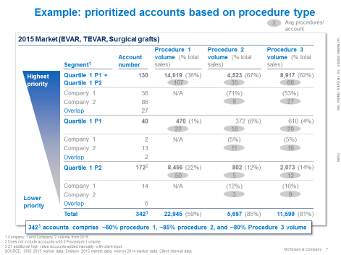
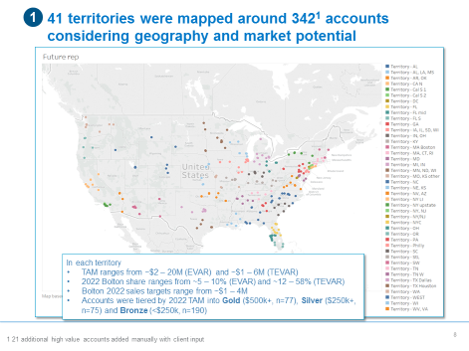
Based on segmentation/prioritization we developed account level deployment strategies with potential 5x increase in sales over next 3 years
Unit of measure
Account segmentation
Account level strategy (deployment)
Impact over the next 3 years is expected to be
5-fold increase in sales
Doubling of original client projected growth rate

